Slide 1
ELECTRICAL SCIENCE-1
(15B11EC111)
Unit-7
Electrical Instruments
( Essentials of an Instrument, Permanent Magnet Moving Coil (PMMC) Instruments, voltmeter, ammeter, Ohmmeter, Meter Sensitivity (Ohms Per-Volt Rating); Loading Effect; Multimeter; Cathode Ray Oscilloscope: Construction, Working and Applications. Function Generators )
Lecture-1
Dr. Abhishek Kashyap
Assistant Professor (Senior Grade, JIIT Noida)

Slide 2
Topics to be covered
ELECTRICAL INSTRUMENTS
PRINCIPLES OF OPERATION OF ELECTRICAL INSTRUMENTS
ESSENTIALS OF AN INSTRUMENT
DEFLECTING TORQUE
CONTROLLING TORQUE
REFERENCES
2

Slide 3
Electrical Instruments
The instruments used to measure electrical quantities (e.g. current, voltage, power, energy etc.) are called electrical instruments.
These instruments are generally named after the electrical quantity to be measured. Thus the instruments which measure current, voltage, power and energy are called ammeter, voltmeter, wattmeter and energy meter respectively.

Slide 4
Principles of Operation of Electrical Instruments
An electrical instrument essentially consists of a movable element and a scale to indicate or register the electrical quantity being measured.
The movable element is supported on jewelled bearings and carries a pointer or sets of dials. The movement of the movable element is caused by utilising one or more of the following effects of current or voltage :

Slide 5
Principles of Operation of Electrical Instruments
The principles of operation of electrical instruments are given in the above table
S. No. | Type of Instrument | Effect | Suitable for | Instrument
1 | Moving-iron | Magnetic effect | d.c. and a.c. | Ammeter, Voltmeter
2 | Permanent-magnet moving coil | Electrodynamic effect | d.c. only | Ammeter, Voltmeter
3 | Dynamometer type | Electrodynamic effect | d.c. and a.c. | Ammeter, Voltmeter, Wattmeter
4 | Induction type | Electro-magnetic induction effect | a.c. only | Ammeter, Voltmeter, Wattmeter, Energy meter
5 | Hot-wire | Thermal effect | d.c. and a.c. | Ammeter, Voltmeter
6 | Electrolytic meter | Chemical effect | d.c. only | Ampere-hour meter
7 | Electrostatic type | Electrostatic effect | d.c. and a.c. | Voltmeter only

Slide 6
Essentials of an Instrument
An instrument essentially consists of moving system pivoted in jewel bearings.
A pointer is attached to the moving system which indicates on a graduated scale, the value of the electrical quantity being measured.
In order to ensure proper operation of instruments, the following three torques are required :
Deflecting (or operating) torque
Controlling (or restoring) torque
Damping torque

Slide 7
Essentials of an Instrument
The deflecting torque is produced by utilising the various effects of electric current or voltage and causes the moving system (and hence the pointer) to move from zero position.
The controlling torque is provided by spring or gravity and opposes the deflecting torque. The pointer comes to rest at a position where these two opposing torques are equal.
The damping torque is provided by air friction or eddy currents. It ensures that the pointer comes to the final position without oscillations, thus enabling accurate and quick readings to be taken.

Slide 8
Deflecting Torque
One important requirement in indicating instruments is the arrangement for producing deflecting or operating torque (T_{d}) when the instrument is connected in the circuit to measure the electrical quantity.
This is achieved by utilising the various effects of electric current or voltage.
The deflecting torque causes the moving system (and hence the pointer attached to it) to move from zero position to indicate on a graduated scale the value of electrical quantity being measured.

Slide 9
Controlling Torque
If deflecting torque were acting alone, the pointer would continue to move indefinitely and would swing over to the maximum deflected position irrespective of the magnitude of current (or voltage or power) to be measured.
This necessitates to provide some form of controlling or opposing torque (T_{C}).
This controlling torque should oppose the deflecting torque and should increase with the deflection of the moving system.
The pointer will be brought to rest at a position where the two opposing torques are equal i.e. T_{d} = T_{C}.

Slide 10
Controlling Torque
The controlling torque performs two functions :
It increases with the deflection of the moving system so that the final position of the pointer on the scale will be according to the magnitude of current (or voltage or power) to be measured.
It brings the pointer back to zero position when the deflecting torque is removed. If it were not provided, the pointer once deflected would not return to zero position on removing the deflecting torque.

Slide 11
Controlling Torque
The controlling torque in indicating instruments may be provided by one of the following two methods :
By one or more springs ... Spring control
By weight of moving parts ... Gravity control

Slide 12
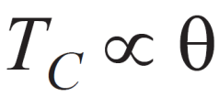
Controlling Torque
Spring Control.
This is the most common method of providing controlling torque in electrical instruments.
A spiral *hairspring made of some non-magnetic material like phosphor bronze is attached to the moving system of the instrument as shown in Fig.
With the deflection of the pointer, the spring is twisted in the opposite direction.
This twist in the spring provides the controlling torque.
Since the torsion torque of a spiral spring is proportional to the angle of twist, the controlling torque is directly proportional to the deflection of the pointer i.e.

Slide 13
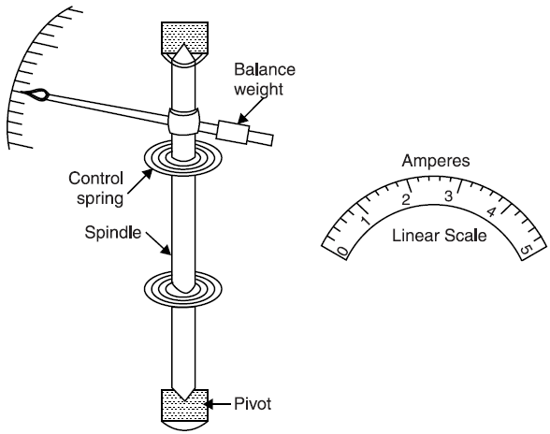
Spring Control.
The pointer will come to rest at a position where controlling torque T_{C} is equal to the deflecting torque T_{d} i.e. T_{d} = T_{C}.

Slide 14
Spring Control.
In an instrument where the deflecting torque is uniform, spring control provides a linear or evenly-spaced scale over the whole range.
For example, in a permanent-magnet moving coil instrument, the deflecting torque is directly proportional to the current flowing through the operating coil i.e.
T_{d} ∝ I
With spring control, T_{C} ∝ θ
In the final deflected position, T_{d} = T_{C}
∴ θ ∝ I
Since the deflection is directly proportional to I, scale of such an instrument will be *linear (uniform).

Slide 15
Spring Control.
Advantages
The levelling of the instrument is not required if the moving parts are balanced.
In some instruments (e.g. permanent-magnet moving coil and dynamometer type), springs also serve as the current leads to the moving coil.
There is practically no increase in the weight of the moving system.
In instruments where deflecting torque is uniform, spring control provides uniform scale.
Disadvantages
Change of temperature affects the spring length and hence the controlling torque.
Controlling torque cannot be adjusted easily.
Accidental stresses in the springs may damage them.

Slide 16
References
Charles K. Alexander (Author), Matthew N.O Sadiku, “ Fundamentals of Electric Circuits”, 6th ed, Tata Mc Graw Hill, 2019..
D.C. Kulshreshtha, Basic Electrical Engineering, Revised 1st ed, Tata Mc Graw Hill, 2017.
V. K.Mehta, Rohit Mehta, Basic Electrical Engineering, 6th ed, S. Chand Publishing, 2012.

